Slide 1



Slide 2

CONTENT
ABOUT US
VISION AND MISSION
HR CAPACITY
REVENUE
OUR PRODUCTS & PROJECTS
PARTNERS
MANAGEMENT TEAM

Slide 3
ABOUT US
VNLINK TECHNOLOGY AND COMMUNICATION JOINT STOCK COMPANY
Through a journey of development, VNLINK has affirmed its position in the information technology industry. We are constantly striving to develop with the mission of providing the best information technology solutions, software and products to customers.
VNLINK gathers a team of experienced experts who always update the latest technology trends in the world to solve the existing hindrances.
We are always confident with our solutions to meet all the requirements from our customers. When coming to VNLINK, customers are not only assured of product quality but also feel the enthusiasm and passion for technology of our qualified and experienced staff.
CORPORATE REGISTRATION NUMBER
0109058713

Slide 4



VISION
With over 15 years of experience in Technology field, VNLINK BOD has set the company’s development path on the steady, long-term, sustainable cooperation with partners, as well as rendered service to the customers from bottom of the heart .
With a focus on travel technology products, VNLink takes the opportunity to be a pioneer in digital transformation in conjunction with Telecommunication Company to for mutual development and become a leading solution provider for Domestic travel companies with 4.0 technology platform.

Slide 5




MISSION
TO MARKET
To provide the best service, the best product of international quality.
TO PARTNERS
To uphold the cooperative spirit of mutual development
To undertake to become a “reliable partner” in every participated project
To constantly advance attractive and sustainable investment value
TO STAFF
To build up a professional, dynamic, creative and humane working environment; To offer a high income and fair opportunity for every staff
TO SOCIETY
To provide support to travel businesses step by step to get access to modernize management, digital transformation on the basis of 4.0 technology

Slide 6
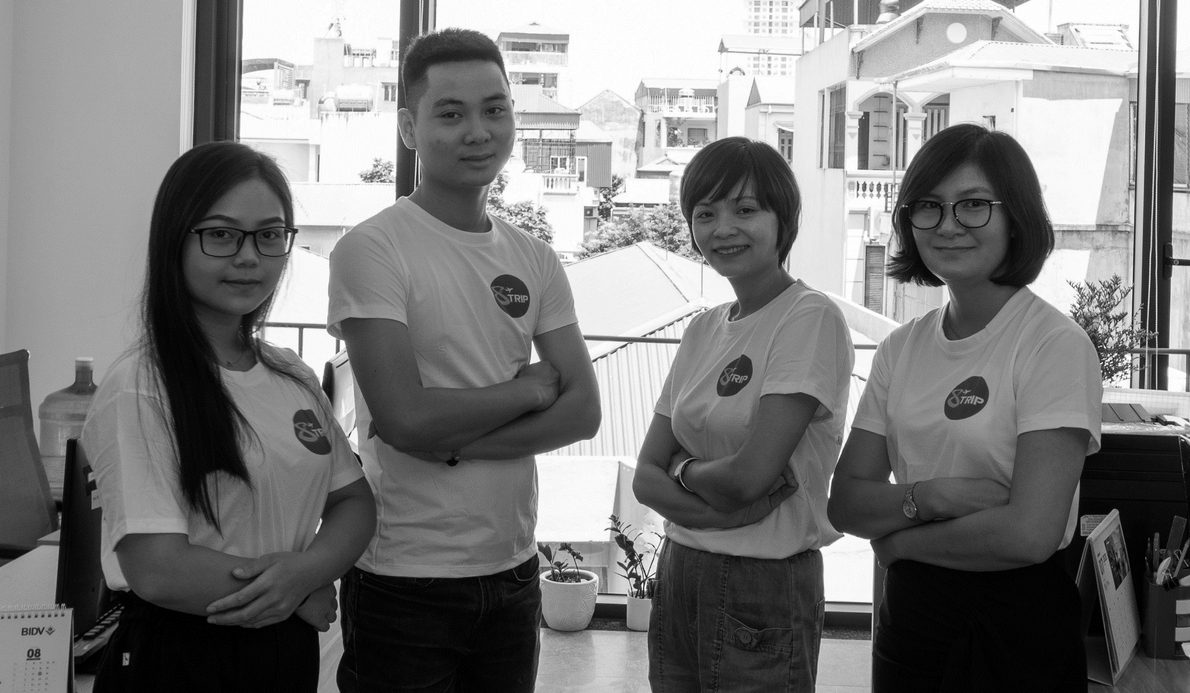
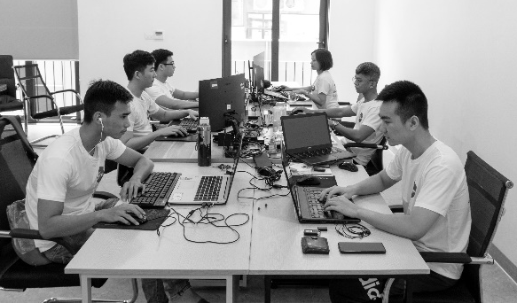
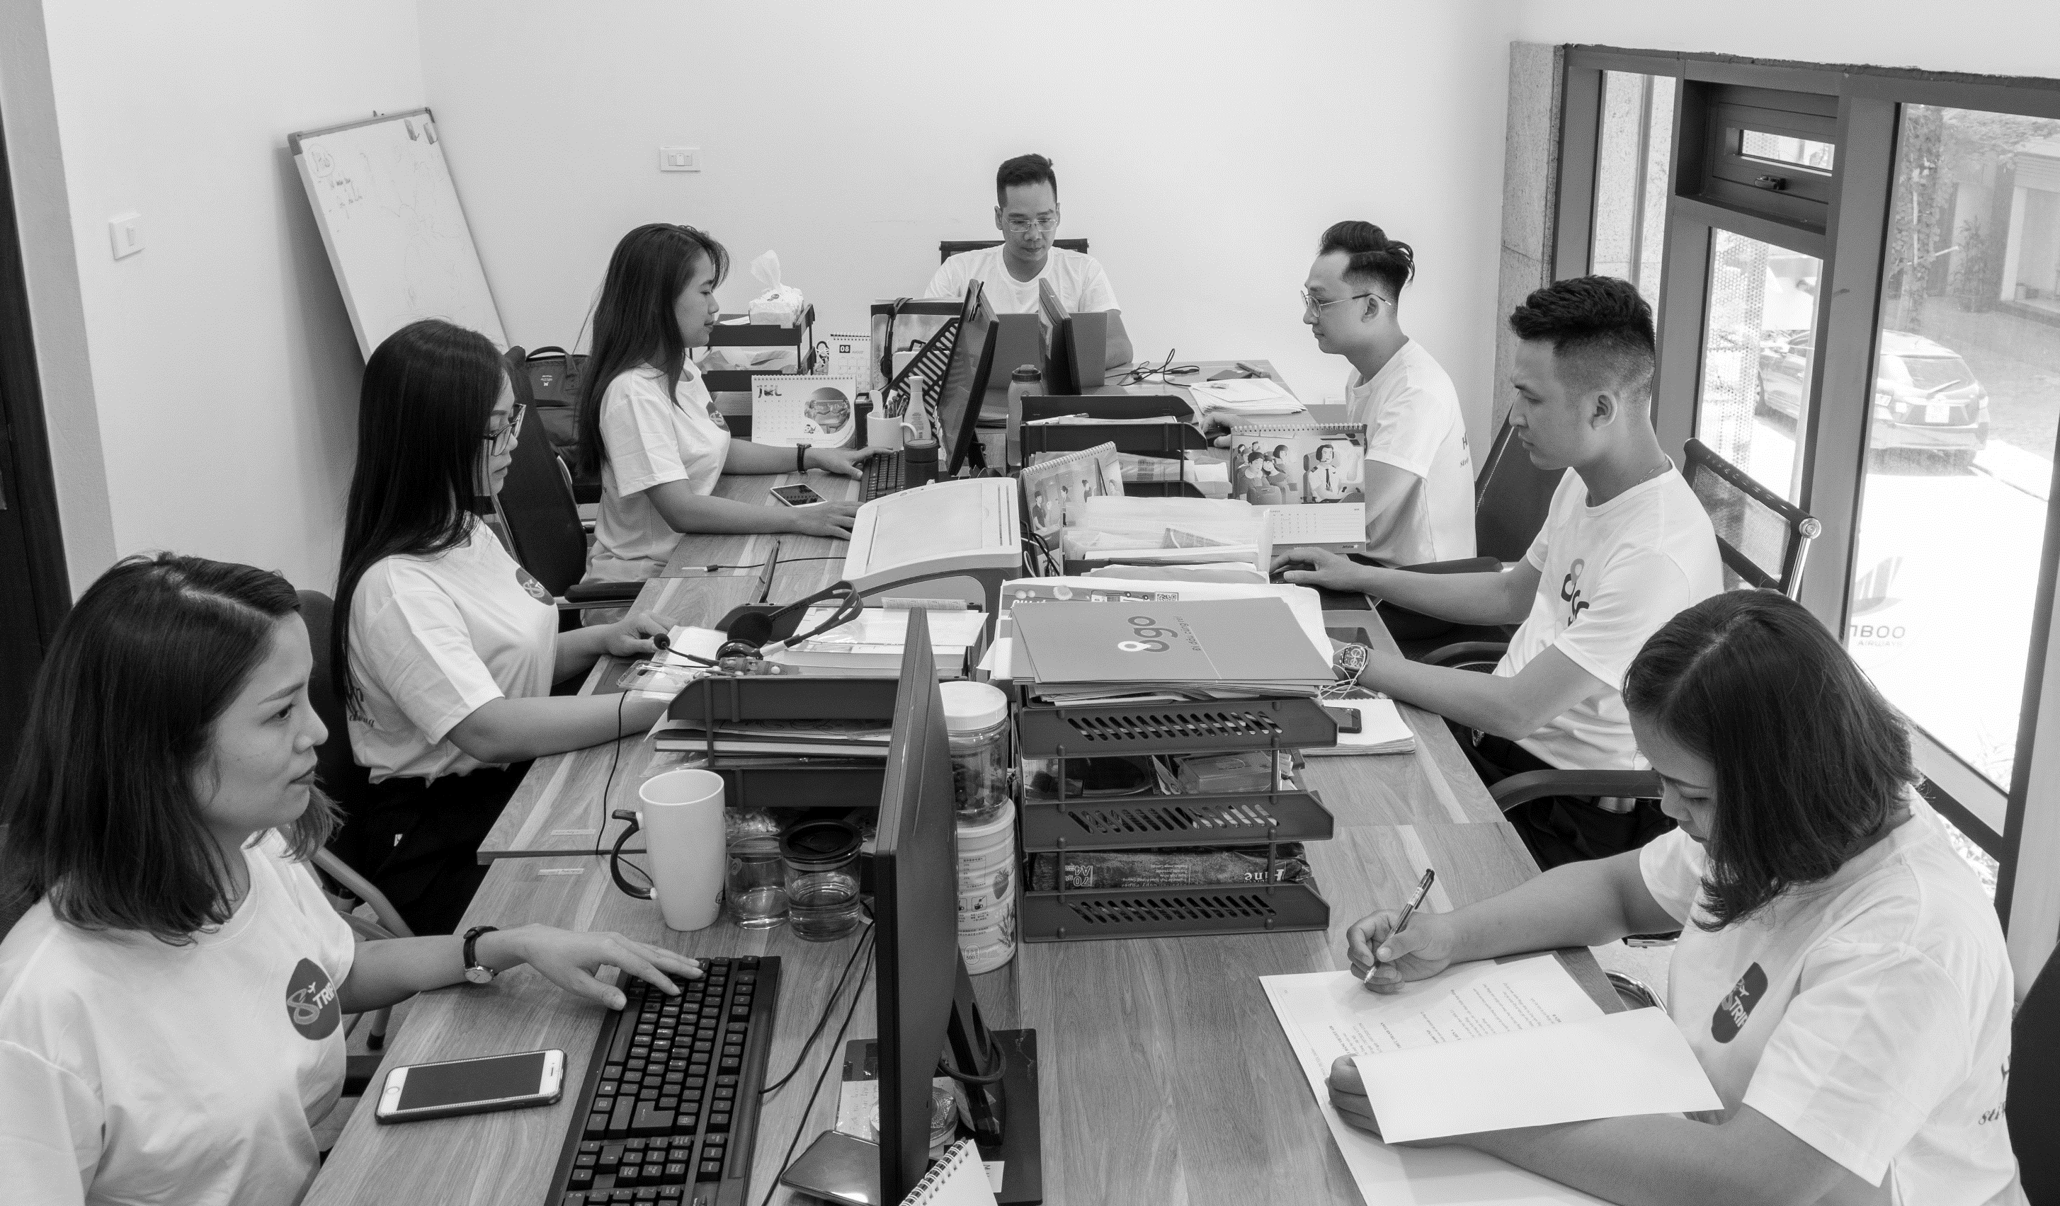
HR CAPACITY
The management team has many years of experience in information technology consultation solutions, building production processes in accordance with CMMi standards, as well as managing many projects of state agencies, domestic and foreign enterprises of different sizes.
Our development team has many years of experience in IT field, working with professional ethics, trained and certified by reputable IT firms, we will always be ready to meet all customer requirements.
The service department has at least 4 years of working experience in airline ticketing and tour operating.

Slide 7
REVENUE
VNLink’s Revenue from 2018 - 2019 can be seen as a spectacular development when achieving impressive growth in accordance with the tourism boom in Vietnam.
In 2020, despite the Covid-19 pandemic, which heavily affected the business revenue to not reach its full potential, however the company still achieved several cooperation with notable customers and had a positive gross profit.

Slide 8
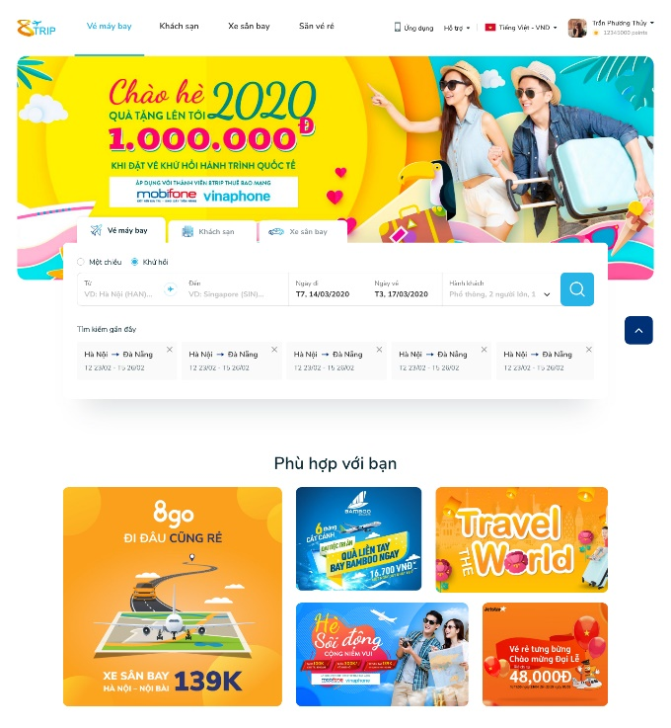
OUR PRODUCT - 8Trip
Description:
8trip is born with the desire to develop a search engine and planning tool for customers travel trip by matching the most suitable airplane tickets, hotels and reasonable price shuttle cars
8Trip provides:
Cheap domestic and international air tickets (8Trip has partnerships with 4 domestic airlines and more than 400 airlines in the world).
Cheap airport shuttles
Best price hotels
Tours
Start date: 2018

Slide 9
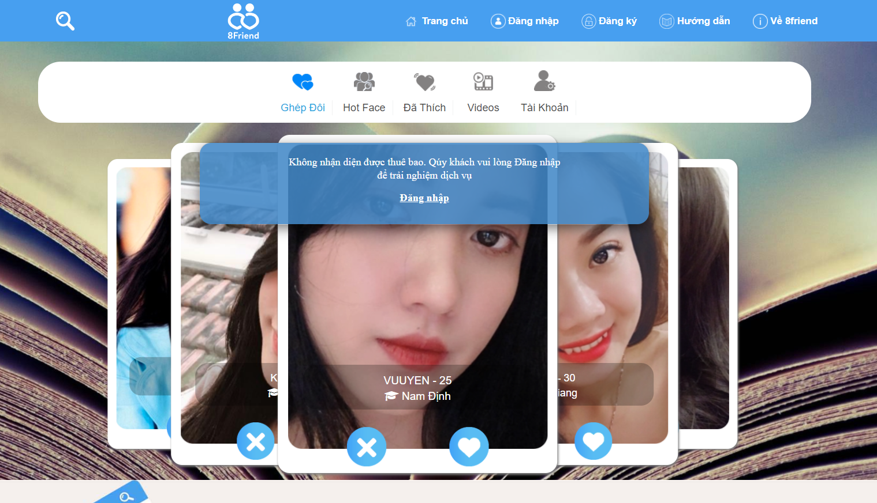
OUR PRODUCT– 8Friend
Description:
8Friend is a dating social network, a product in partnership with Mobifone, allowing users to upload their videos/photos to introduce themselves. At the same time, 8Friend has built-in call feature and video clip playback.
8Friend provides:
8Call package: Allows users to make free calls to Mobifone subscribers
8VoD Package: For Mobifone subscribers to enjoy a huge video storage of attractive entertainment content.
Start date: 2018

Slide 10
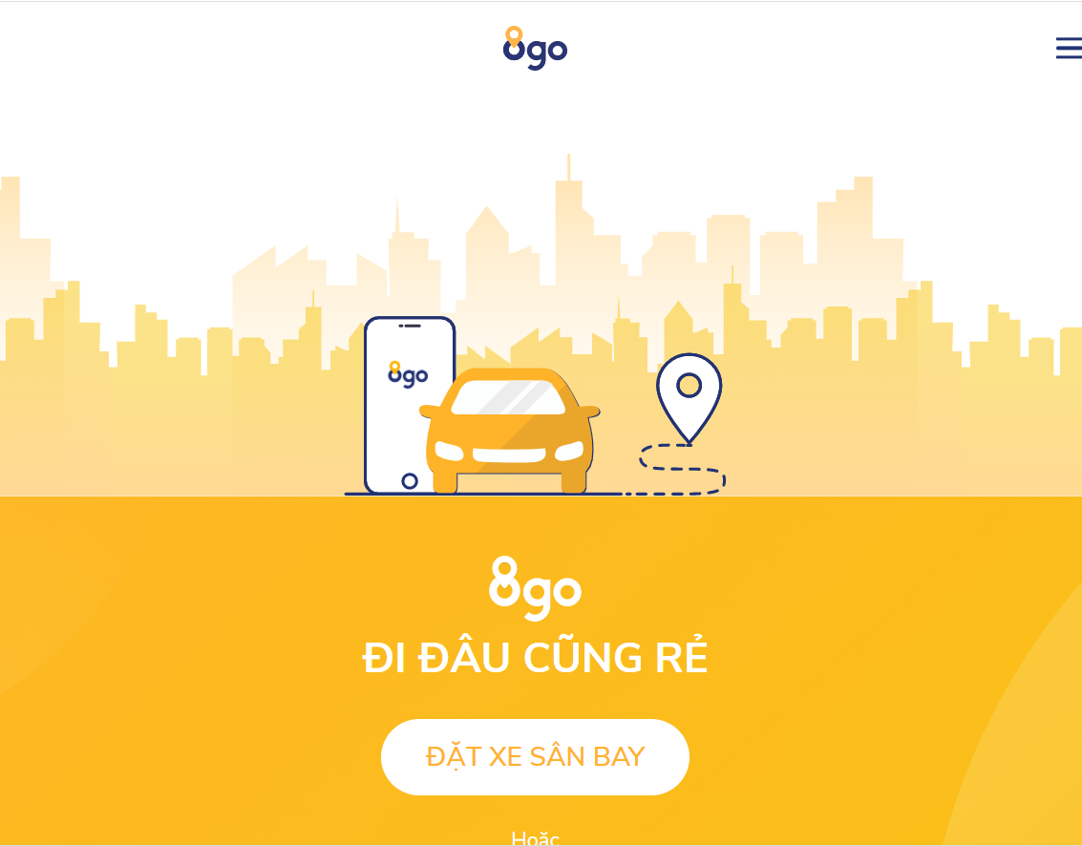
OUR PRODUCT – 8Go
Description:
8GO car booking service applies technology and artificial intelligence to create a transportation system where supply and demand meet in the most perfect way, so that the service price is the lowest, having highest efficiency. The product striving for the core values ​​of convenience, safety, cost savings and civility when traveling
8Go provides:
Car booking: inner city drive and cross-province drive
Airport shuttle (notification for drivers and customers if the flight is delayed)
Start date: 2018

